Slide 1
PETER PAN J. M. Barrie
Teacher Paola Forte
2016/2017

Slide 2
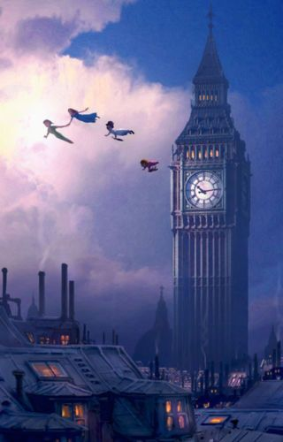
THIS IS LONDON

Slide 3
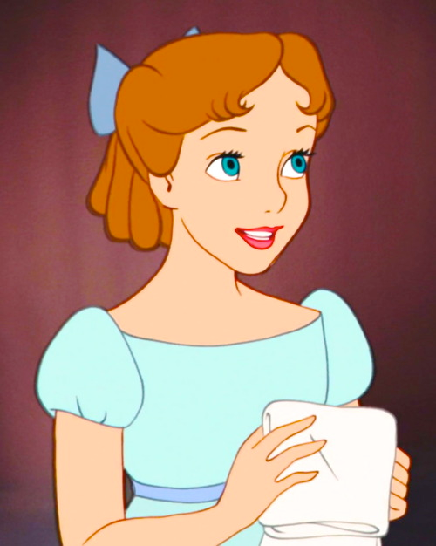
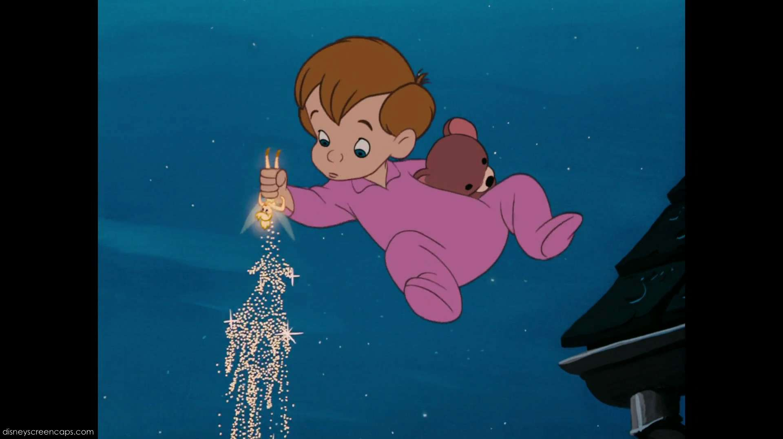
WHO LIVES HERE?
WENDY, JOHN AND MICHAEL LIVE IN LONDON.

Slide 4
THEY LIVE IN A BIG HOUSE

Slide 5
THEY ARE IN BED

Slide 6
PETER PAN AND TINKERBELL ARE IN LONDON

Slide 7
THEY COME TO THE BIG HOUSE
THEY GO IN

Slide 8
PETER PAN AND TINKERBELL FLY IN THE BEDROOM
PETER PAN LIKES THIS HOUSE

Slide 9
THE BEDROOM IS BIG

Slide 10
JOHN, WENDY AND YOUNG MICHAEL SEE A BOY.
IT IS PETER PAN AND TINKER BELL.

Slide 11
THEY LIVE IN NEVERLAND
NEVERLAND IS MAGICAL

Slide 12
PETER PAN, TINKERBELL AND THE CHILDREN FLY TO NEVERLAND

Slide 13
PETER PAN, TINKERBELL AND THE CHILDREN FLY AND FLY
THEY SEE BIG BEN

Slide 14
THEY ARE HAPPY

Slide 15
BYE BYE LONDON
HELLO NEVERLAND
IT IS BEAUTIFUL

